Slide 1
SMART PARKING LOT

Slide 2
Group members:
Hassan Saeed
Saqib Javed
Abbas Ahmed
M. Ibrahim Zafar
Momin Munir
Saad Abdul Majid

Slide 3
NEED:
Non availability of parking space
Increase in the number of cars on road per day
Confusion in the availability of parking space in parking lot
Welfare of society

Slide 4
Advantages:
Provides parking space
Tells us the number of cars in the lot
Automatic lights which saves energy in day time
Automatically detects small and big cars
Save time by telling drivers about empty lots.
Easy to use
Real time
Cost efficient

Slide 5
How it Performs?
When a car arrives, it opens the door only when the space is available otherwise tells the person that the parking is full.
Opens the door according to the size of the car.
Lights are on only in the dark.
Light only gets on when a car is parked.
Tells the person how much cars are parked inside the lot or the lot is empty.

Slide 6
Working:
When car arrives sensor takes the input and sends it to microprocessor.
If the lot is full then our system shows the output that lot is full.
If lot is not full then it opens the gate and let the car in. (processor increments a car)
If the car is small only 60 degree of the barrier gets lifted.
If the car is large then 90 degree of the barrier is lifted.
Then car goes in at some parking space and the light turns on if it is dark and no other car is present.
In day light remains off
When car goes out the barrier is lifted in same way as mentioned above. (processor decrements a car)
If it is the last car processor shows empty lot and also switches the light off, if it is night.

Slide 7
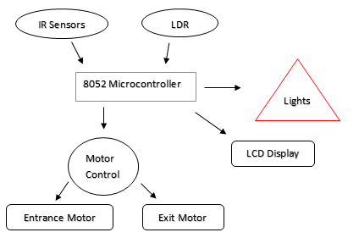
Block Diagram:

Slide 8
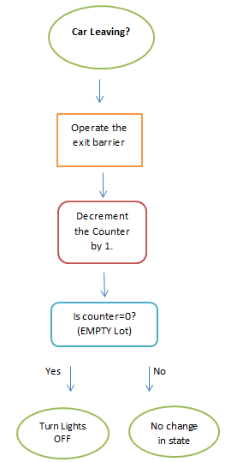
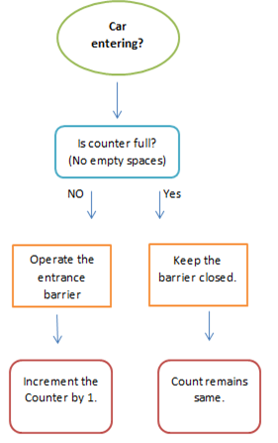
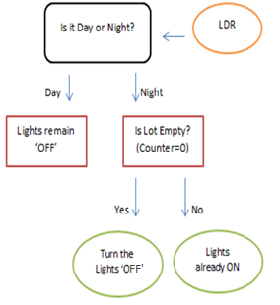
Flow Charts:

Slide 9
Work division:
M. Ibrahim Zafar: Patching, Schematic and coding
Saqib Javed: Patching, Schematic and coding
Abbas Ahmed: Patching, Schematic and coding
Hassan Saeed: Presentation, Patching and algorithm
Momin Munir: Reports and Schematic
Saad Abdul Majid: Brought the components and schematic

Slide 10
Budget:
Cost of different components is as below:
Components: | Quantity: | Price:
IR Sensor Module | 4 | 650
8052 Microcontroller | 1 | 100
16x2 LCD | 1 | 260
LED | 16 | 15
Wires | - | 50
LDR | 1 | 15
Stepper Motors | 2 | 500
Switches | 17 | 170

Slide 11
Components | Quantity | Price
De-Multiplexers | 3 | 200
Resistors | 40 | 20
Stepper Motor driving IC (L293D) | 2 | 160
Crystal Oscillator | 1 | 30
NOT gate | 1 | 30
Capacitor | 2 | 10
Bread Board | 6 | 1200

Slide 12
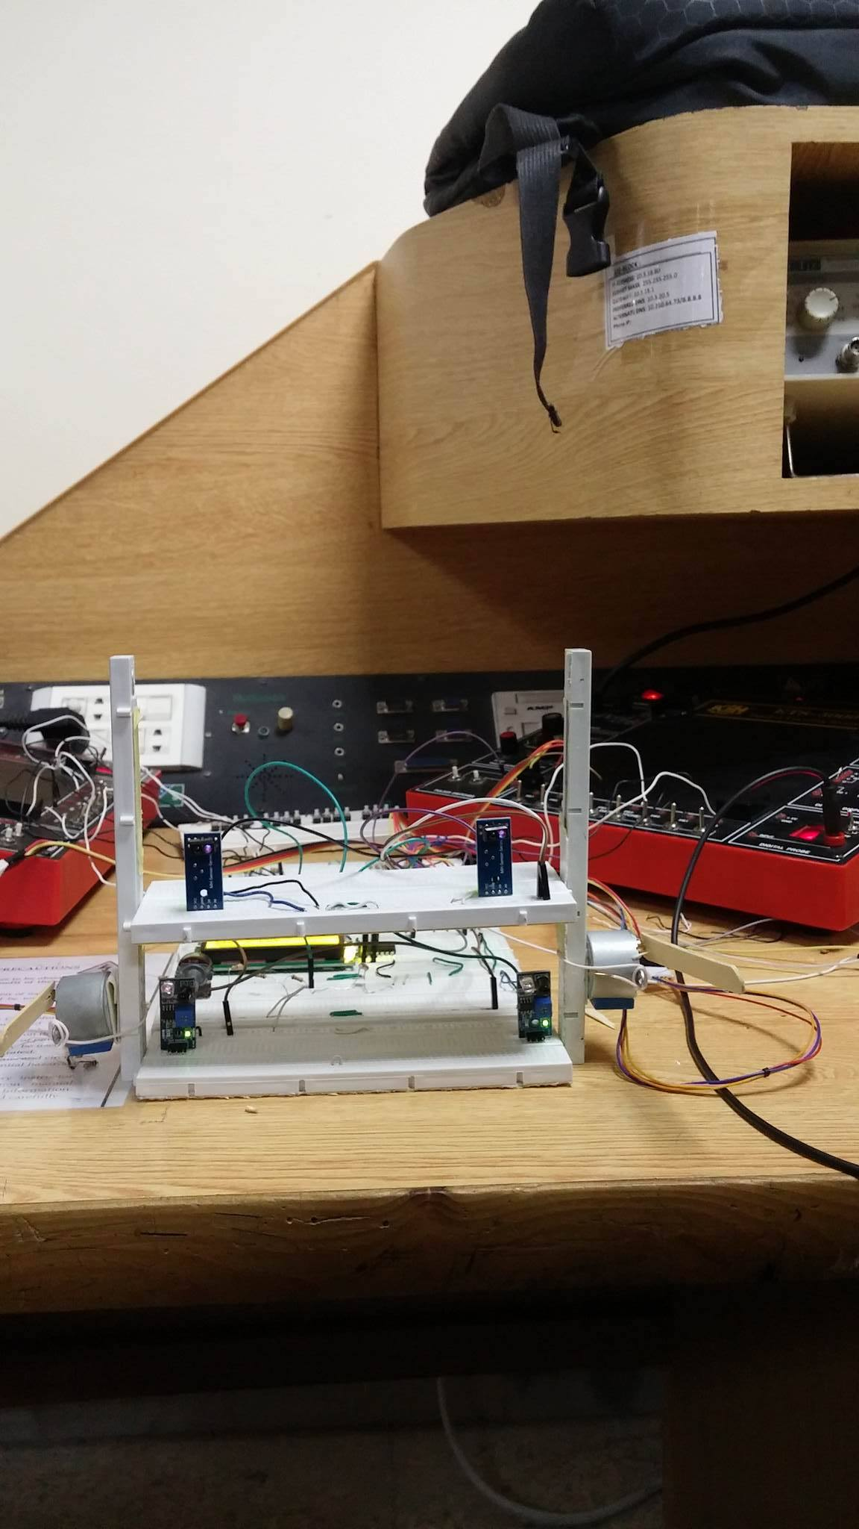
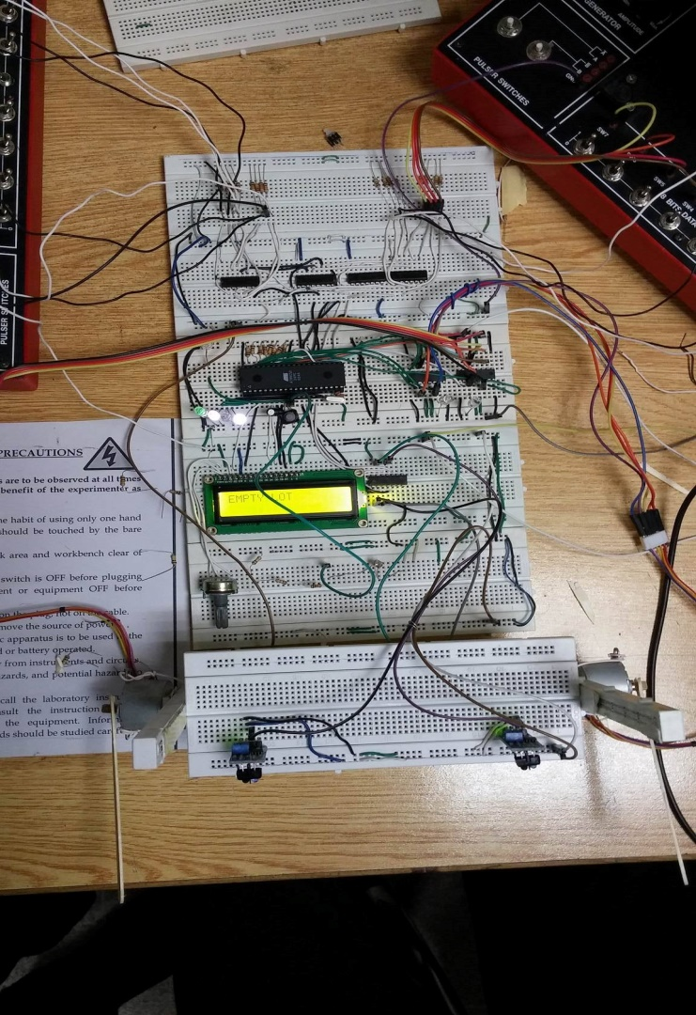
Model:

Slide 13
THANK YOU!

